Slide 1

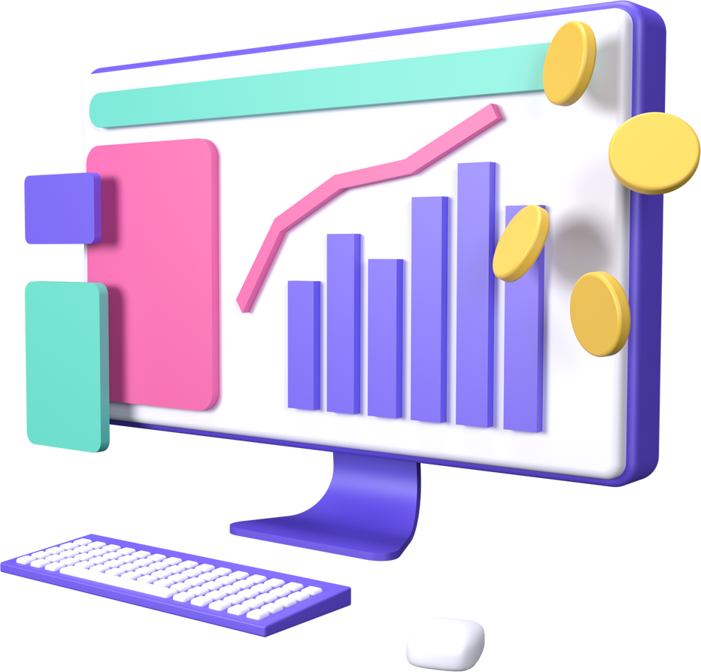

MAHMOUD ELANANY
HUMAN RESOURCES DATASET ANALYSIS
Employee satisfaction and performance

Slide 2

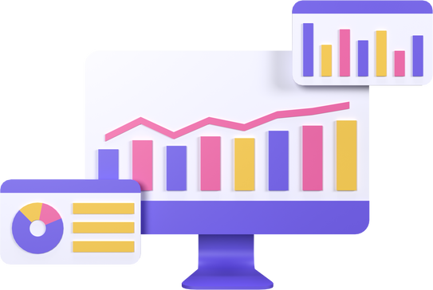


OBJECTIVES
Introduction
Project Goals
Clarification of what will be discussed
A glimpse of what needs to be analyzed
Framework
Results
Tools Used
with Screenshots charts from Tableau

Slide 3
INTRODUCTION
Purpose of the Project:
To analyze employee data to understand the relationship between job satisfaction and performance.
To provide insights that help decision-makers in the organization.

Slide 4
PROJECT GOALS
ANALYZE SATISFACTION AND PERFORMANCE ACROSS DIFFERENT DEPARTMENTS.
CLEAN AND PREPROCESS DATA FOR ANALYSIS.
Build a comprehensive data model.
FEEDBACK

Slide 5
TOOLS AND TECHNOLOGIES USED
Programming: Python (Pandas, Matplotlib, Seaborn)
Data Analysis:
Python, google Colab
Visualization: Tableau
Step 1
Step 2
Step 3
Preparing Final Report and Presentation
Step 4

Slide 6

PROJECT PHASES
Phase 1
Phase 2
Phase 3:
Data Cleaning and Preparation
Data Analysis and Answering Defined Questions
Building a Dashboard
in Tableau

Slide 7


ANALYTICAL QUESTIONS
WHAT ARE THE PERFORMANCE PATTERNS AMONG DIFFERENT DEPARTMENTS?
HOW DOES SATISFACTION VARY BY DEPARTMENT?

Slide 8


RESULTS
RESULTS OF EMPLOYEE SATISFACTION ANALYSIS BY DEPARTMENT.
VISUAL REPRESENTATION OF THE RESULTS USING CHARTS

Slide 9

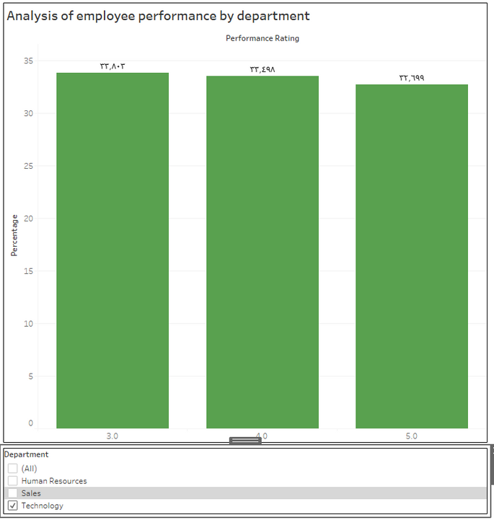
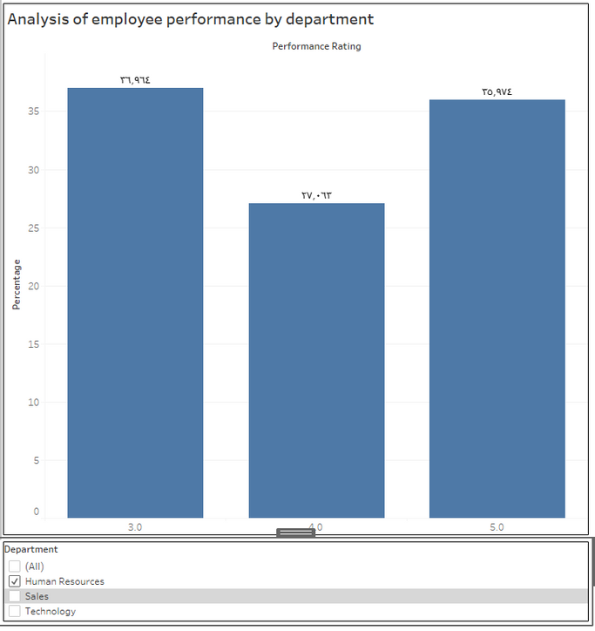
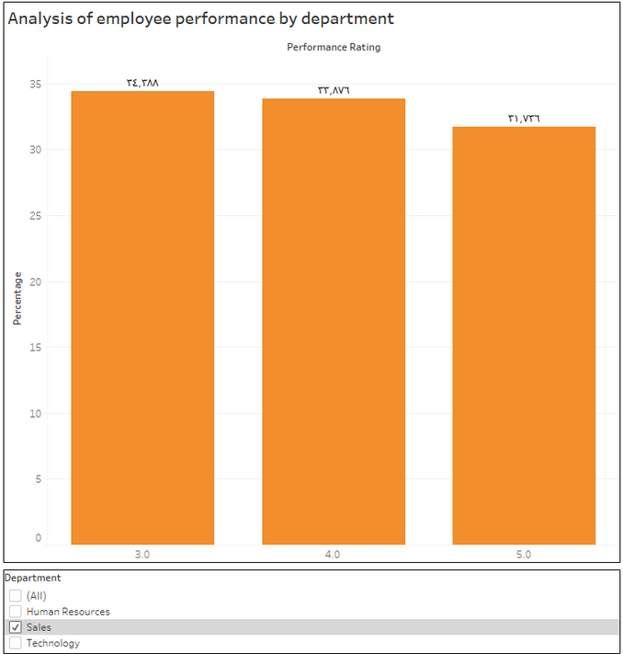
RESULTS
CHARTS FROM TABLEAU

Slide 10
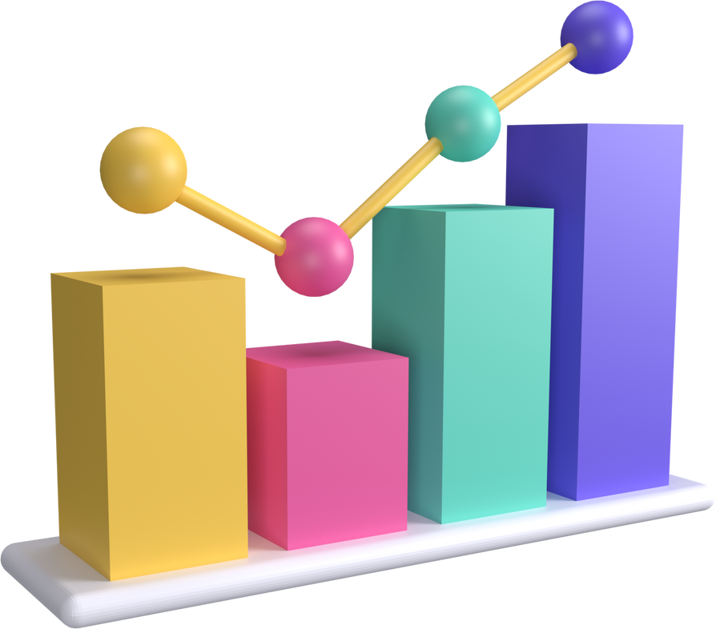
RECOMMENDATIONS
Recommendations Based on Analysis:
Strategies to improve job satisfaction.
Development of training and development programs for departments needing improvement.

Slide 11

CONCLUSION
Summary of the Project:
A comprehensive analysis of data was performed.
The findings provide valuable insights to support decision-making.

Slide 12

Questions and Discussion
Invitation for questions and discussion.

Slide 13

THANK YOU!
Write a closing statement here

